Slide 1

3D Object Detection on nuScenes
Simone Maravigna, Francesco Marotta

Slide 2
Content
Introduction
Dataset
Sensors: Calibration & Synchronization
Networks: FasterRCNN & SNN
Fusion
Results
Conclusion

Slide 3
Introduction
The objective of this project is to create a 3D object detection system designed for autonomous vehicles navigating urban environments. To achieve this goal, two sensors were employed: a Camera and a LIDAR. Utilizing FasterRCNN for the Camera enabled the generation of 2D bounding boxes on the images. Simultaneously, applying SSN for the LIDAR, made it possible to obtain 3D bounding boxes on the 3D point cloud. After the two different types of bounding boxes were extracted, they were fused in the same image. The code was implemented on Pytorch.

Slide 4
nuScenes Dataset

Slide 5
nuScenes Dataset
The nuScenes dataset contains 1,000 driving scenes in densely trafficked cities (Boston and Singapore). Each scene has a duration of 20 seconds. The dataset classifies 23 distinct classes for foreground objects, and each object in the dataset is annotated with accurate 3D bounding boxes. However, for computation efficiency in LIDAR processing, classes are reduced to 10 by grouping some classes and eliminating others.

Slide 6
Sensors: Calibration & Synchronization

Slide 7
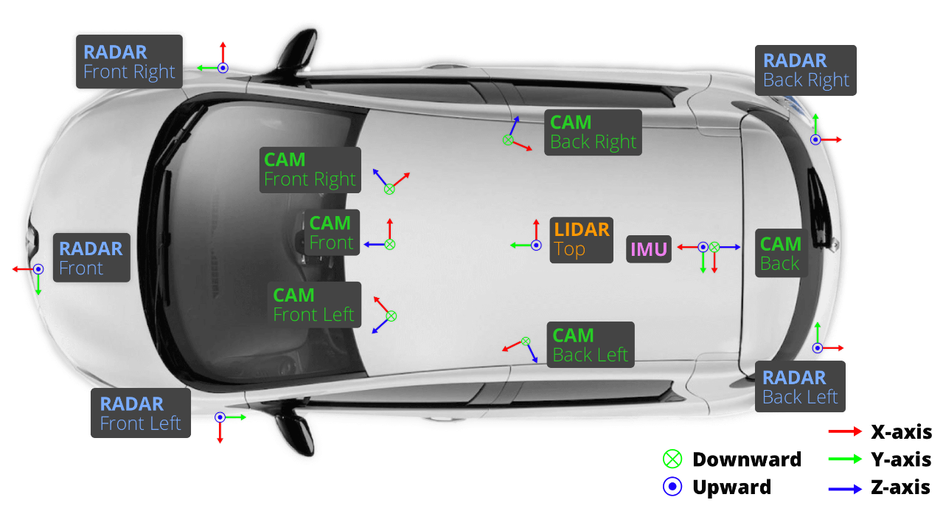
Car Setup

Slide 8
Sensors
Spinning LIDAR
Camera
20Hz capture frequency
360° Horizontal FOV, +10° to -30° Vertical FOV, uniform azimuth angles
80m-100m Range, Usable returns up to 70 meters, ± 2 cm accuracy
Up to ~1.39 Million Points per Second
12Hz capture frequency
Evetar Lens F1.8 f5.5mm 1/1.8«
1/1.8'' CMOS sensor of 1600x1200 resolution
1600x900 ROI is cropped from the original resolution to reduce processing and transmission bandwidth

Slide 9
Sensor Calibration
In order to create a high quality multi-sensor dataset, it is crucial to calibrate the extrinsic and intrinsic parameters of each sensor. Extrinsic coordinates are defined with respect to the ego frame, specifically the midpoint of the rear vehicle axle.

Slide 10
Sensor Synchronization
To achieve good cross-modality data alignment between the LIDAR and the cameras, the camera’s exposure is triggered when the top LIDAR sweeps across the center of the camera’s FOV. As the camera's exposure time is nearly instantaneous, this approach typically yields good data alignment.
It's worth noticing that the cameras operate at a frequency of 12Hz, while the LIDAR operates at 20Hz. The 12 camera exposures are distributed as evenly as possible across the 20 LIDAR scans, meaning that not every LIDAR scan has a corresponding camera frame.

Slide 11
Networks: FasterRCNN & SNN

Slide 12
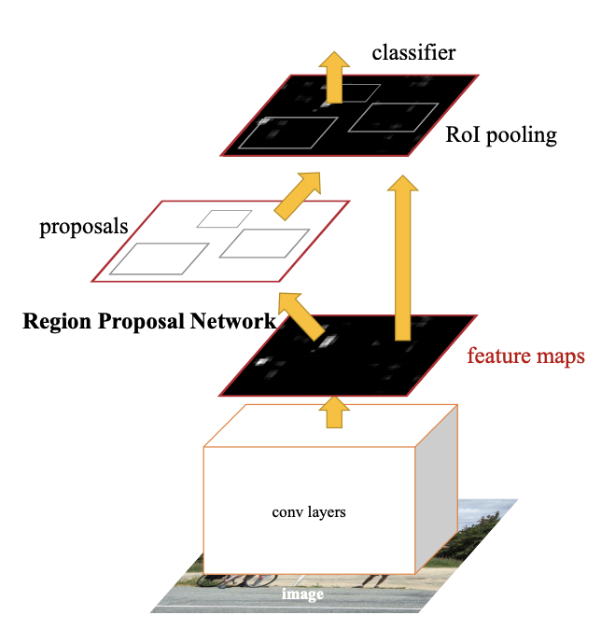
Networks: FasterRCNN
FasterRCNN was deployed to extract bounding boxes from camera images.
Firstly, it suggests regions where objects might be, and then it classifies the objects within those regions, refining the corresponding bounding boxes.
Notes:
Region Proposal Network (RPN): This part of Faster R-CNN suggests potential regions in the image where objects might be present. These regions are called "proposals."
Feature Extraction: The image is passed through a convolutional neural network (CNN) to extract features. This helps the model understand the content and context of the image.
Region of Interest (RoI) Pooling: The proposed regions are aligned to a fixed size and shape, creating a region of interest. This step ensures that the model can work with regions of varying sizes.
Classification and Regression: The features from the RoI are used for both classifying the object present in that region and refining the bounding box around the object.

Slide 13
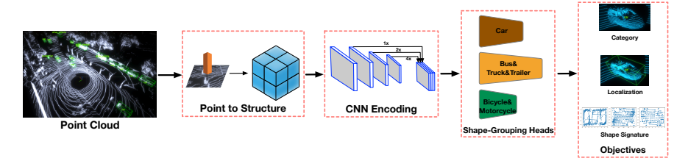
Networks: Shape Signature Network
Shape Signature Network was used to extract 3D bounding boxes from LIDAR point cloud.
It consists of 4 main components: point-to-structure, pyramid feature encoding, shape-aware grouping heads and multi-task objectives.
Notes:
Point-to-Structure part, which converts the raw points into the structured representation, Voxels or Pillars
Pyramid feature encoding extracts hierarchical features from the point cloud
Shape-aware grouping heads group points based on their shape similarity, facilitating the identification of objects with similar shapes.
The final part is the objective, including classification, localization and shape signature regression

Slide 14
Fusion

Slide 15
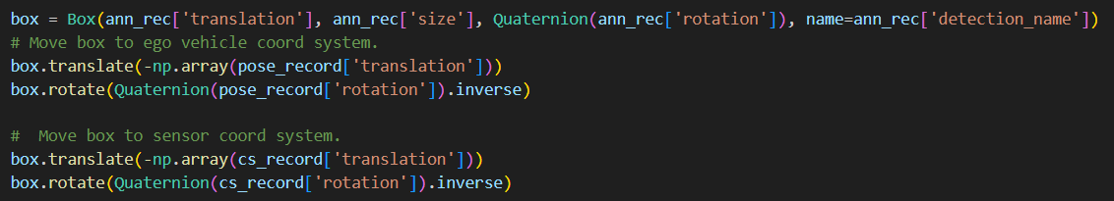

Fusion
Each network produces an output in the form of .json file, which includes bounding boxes for every frame, where each frame is identified by a token. Each box is then generated, translated to the ego vehicle coordinate system, moved to the camera coordinate system and ultimately rendered onto the image.
Notes:
Images = [x1,y1,x2,y2]
Point clouds = translation(3 element matrix), rotation (4 element matrix)

Slide 16
Results

Slide 17
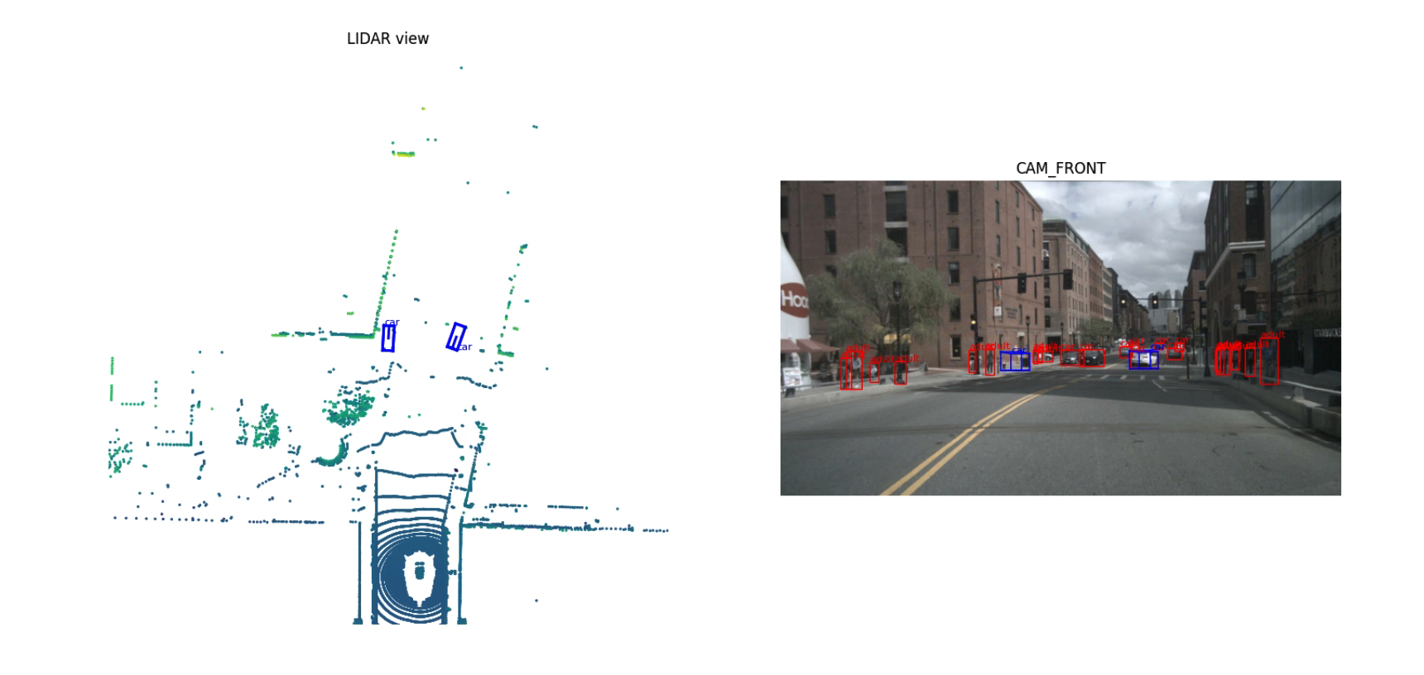
Qualitative Results

Slide 18
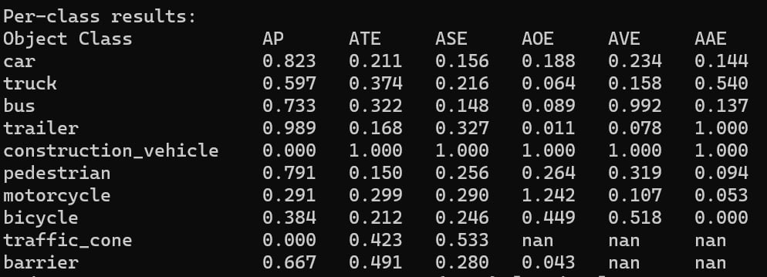
Quantitative Results
After the inference on the two networks, a 48% mAP was achieved on the images, while a 52% mAP was obtained on the LIDAR point cloud.

Slide 19
Conclusion
The results indicate that the model excels in recognizing nearby objects when utilizing LiDAR, whereas with the camera, it demonstrates the capability to retrieve information even from distant, small objects.
It is crucial to note that we did not train the LiDAR model, and due to computational resource constraints, we selected the lightest model available from the mmdetection model portfolio. Consequently, with a more sophisticated model, such as PointPillars, we anticipate achieving superior and more accurate 3D predictions.

Slide 20
Difficulties and Take-Home Message

Slide 21
Difficulties
Take-Home Message
Dealing with LIDAR point clouds and networks that deals with that
Dealing with mmdetection3d suite
Limited computational resources
Learned how to handle projection between different reference frames
Meeting deadline is possible without sleeping

Slide 22
Q&A

Slide 23
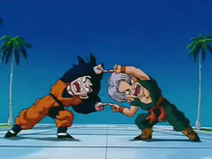
Thank you!
CAMERA
LIDAR

